Slide 1
WAVES
Water and Versatile Energy Systems
Sean Henely
Laura Hereford
Mary Jung
Tatsuya Saito
Edward Toumayan
Sarah Watt
Melanie Wong
Mentor: Dr. James Duncan
Librarian: Nevenka Zdravkovska

Slide 2
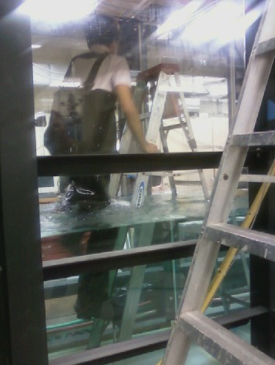
Agenda
Introduction
  Research Problem
  R-WEC
Engineering Concepts
Research Questions
Hypotheses
Methodology
Construction
Testing
Team Composition
Conclusion
  Current Status
  Future Direction
Advice for Freshmen

Slide 3

Introduction: Research Problem
Shift towards clean, renewable energy sources
The study of ocean energy will increase the viability of this technology
Ocean wave action delivers 2,700 gigawatts (GW) of power
500 GW are available
50 GW are of practical use for energy conversion

Slide 4
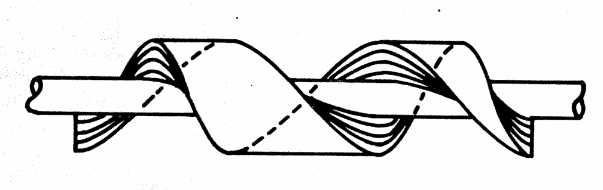
Introduction: R-WEC
Rotary Wave Energy Converter (R-WEC)
Power output measured by weight-pulley system
Materials:
  Closed cell syntactic foam
  Aluminum rod
Dimensions:
  Length: 6 ft
  Outer diameter: 4 in
  Inner diameter: 1 in
  Pitch: 4 ft
Radius
Pitch
Length

Slide 5
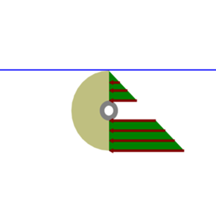
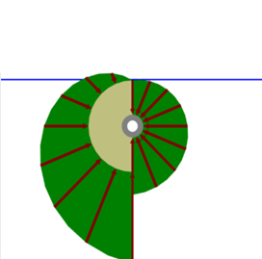
Engineering Concepts
Angular Pressure
  Tangential to outer surface of device
  Contributes to moment on device
  Resultant force causes device to rotate
Radial Pressure
  Normal to outer surface of device
  Contributes to the buoyancy of the device
  Resultant force causes device to float

Slide 6
Research Questions
How can we maximize the power output of a Rotary Wave Energy Converter as a function of wave conditions?
  Wave amplitude
  Wave frequency
  Random sea states
How can the physical characteristics of the rotor system be adjusted to increase power output?
  Rotor
  Mooring system

Slide 7
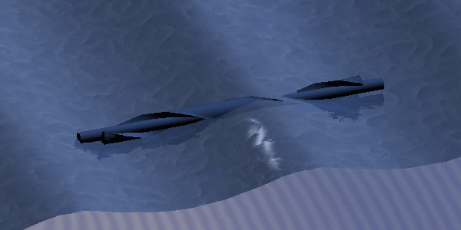
Hypotheses
The optimum wave amplitude is equal to the outer radius of the R-WEC
The optimum wavelength is equal to the pitch of the foam spiral
We need a mooring system that allows the rotor to be parallel to the waves at all times

Slide 8
Methodology
Experimental Design
  Effect of wave characteristics on power output
  Effect of rotor system on power output
Goals:
  Construct and test multiple wave rotors
  Determine optimal wave conditions for each rotor
  Determine the most optimal mooring system for the R-WEC
  Determine how to maximize power output in random sea states

Slide 9
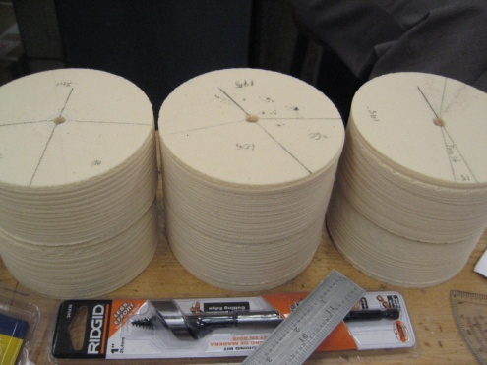
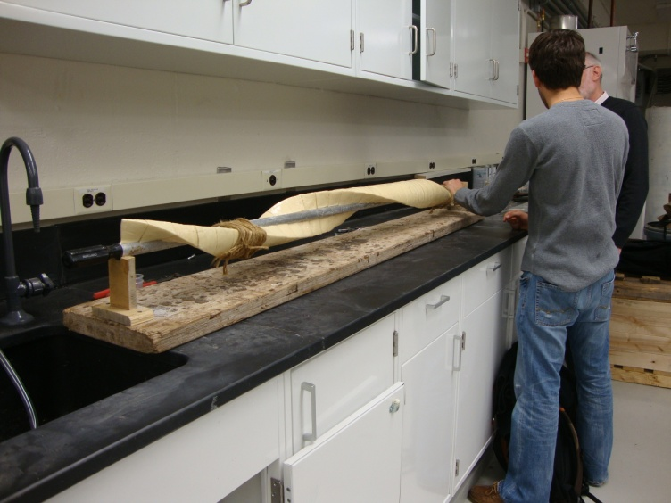
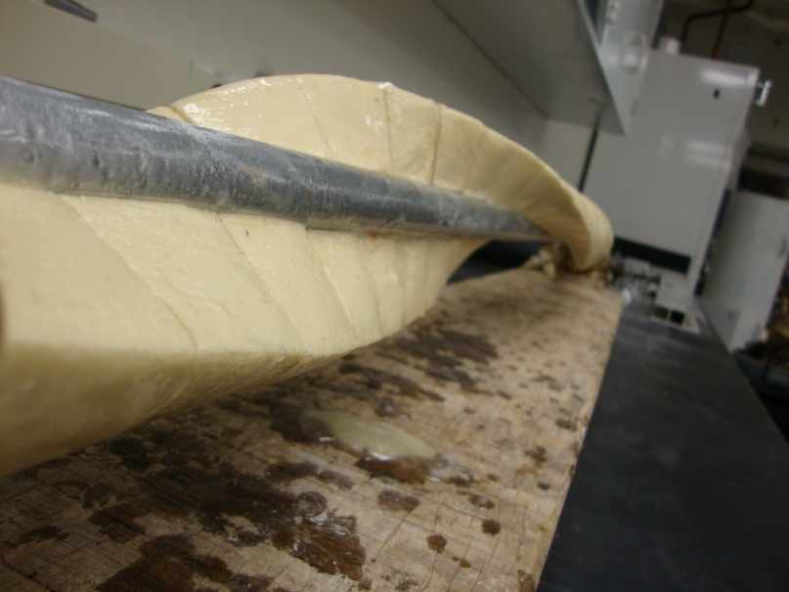
Construction

Slide 10
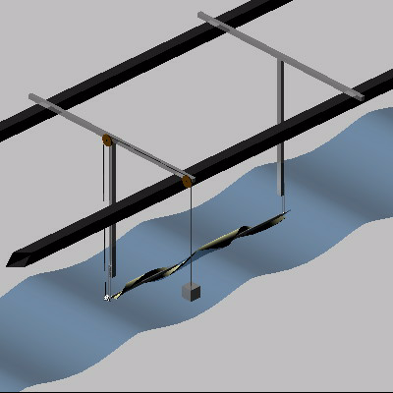
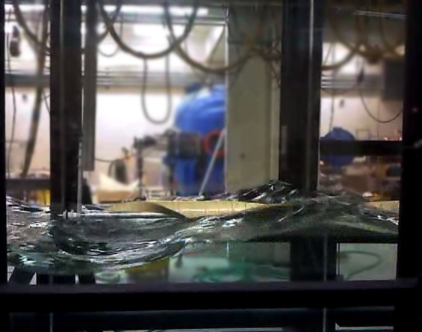
Testing
In the wave tank
Simulation

Slide 11

Team Composition
Testing
Subgroups
  Construction
  Mooring
  Power Generation
Process
  Group and subgroup meetings
  Additional work times
Notes:
Construction subgroup will begin testing of the next prototype
Mooring and power generation merged to begin testing

Slide 12
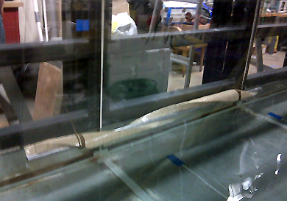
Conclusion: Current Status
Researched wave energy devices and testing methods
Determined characteristics of our rotor for construction
  Material
  Dimensions
Built first rotor
Completed mooring structure
Tested floatation
Ran multiple trials:
  Achieved constant rotation
Notes:
Fluid properties: buoyancy

Slide 13
Conclusion: Future Direction
Now that the R-WEC can harness energy in the lab, real world factors must be taken into account for application in open waters
Timeline for success:
JUNIOR YEAR 2009-2010
  Test the current prototype in different wave conditions and sea states
  Optimization
  Explore mooring systems
  Begin data analysis
SENIOR YEAR 2010-2011
  Complete data analysis
  Complete thesis
  Thesis conference

Slide 14

Advice for Freshmen
Small Group Dynamics
Diverse Composition
Time Management
  Make a schedule
  Sign in/out of lab
Write everything down
  Google groups
  Frequent emails
Notes:
Group Dynamics: our experiences as a small group
Diverse Composition: everyone learns through the process whether or not your major applies to your project

Slide 15

Questions?

